Slide 1
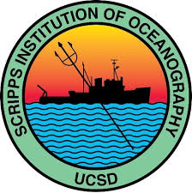
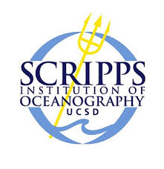
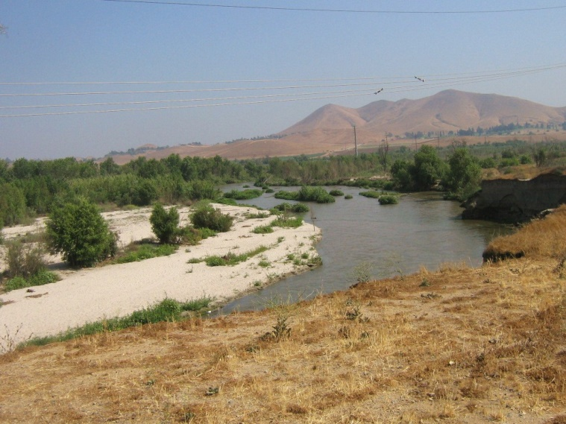
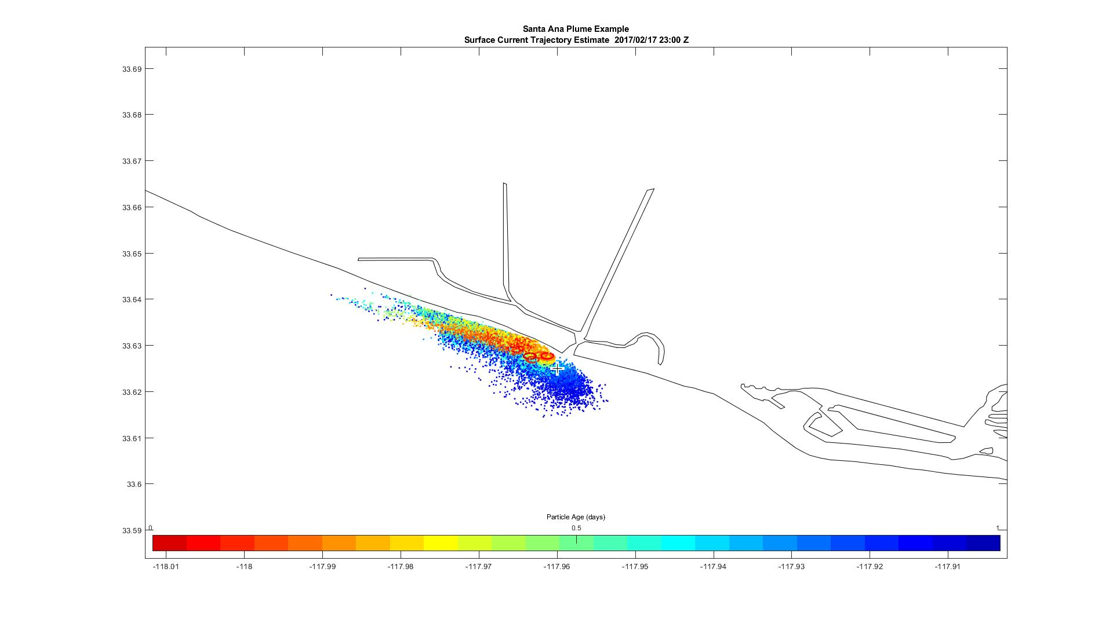
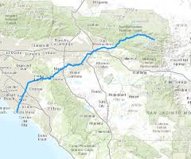
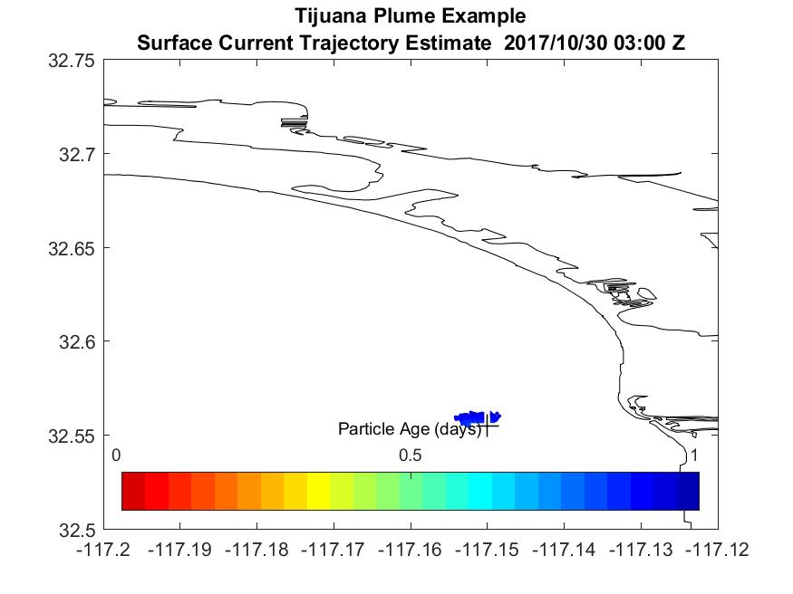
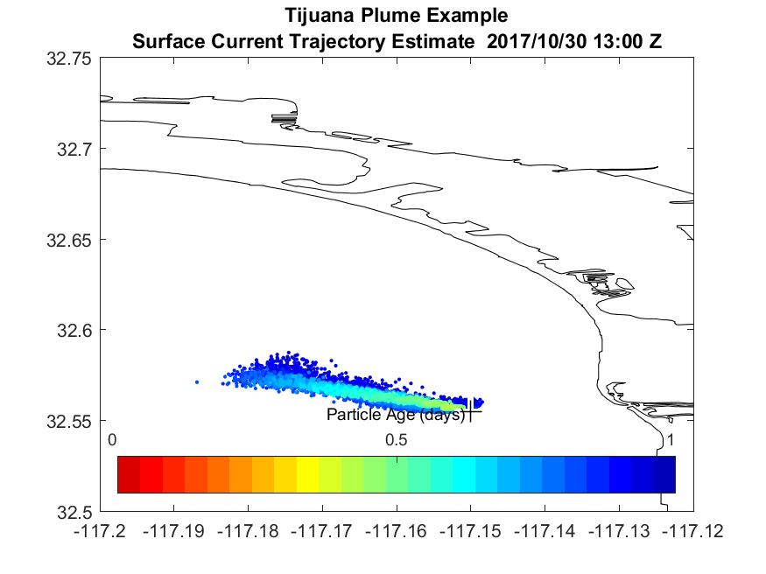
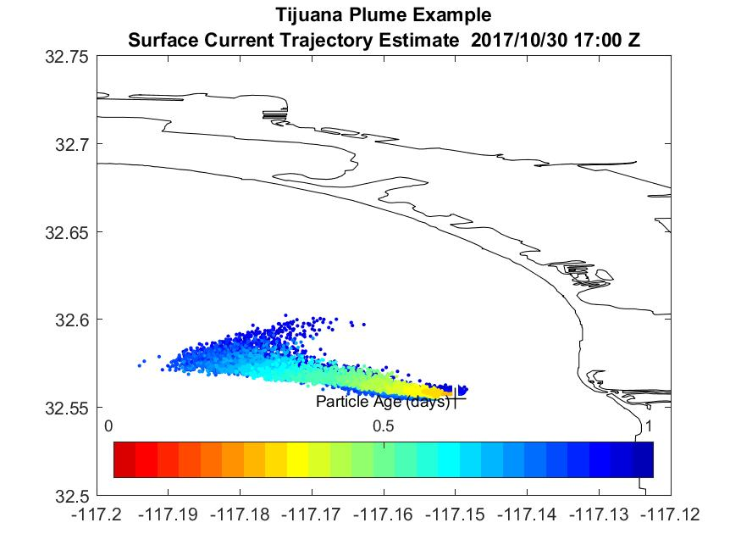
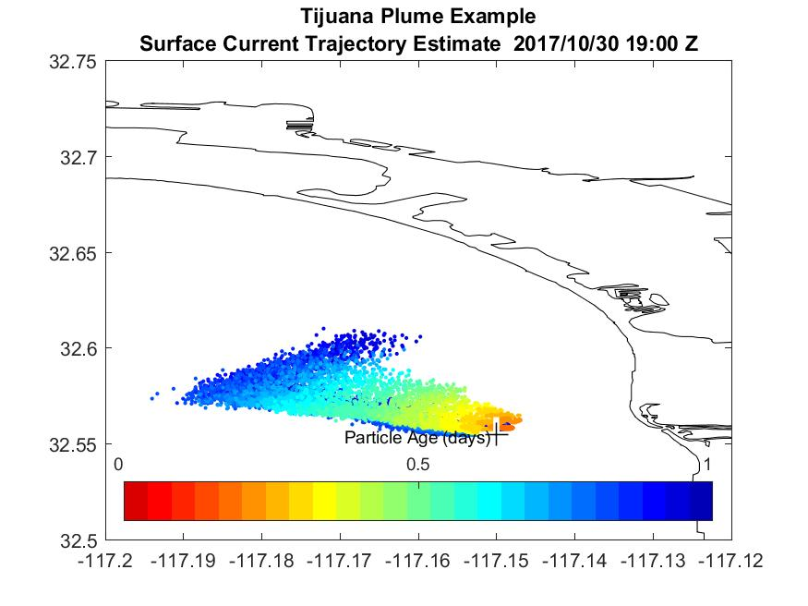
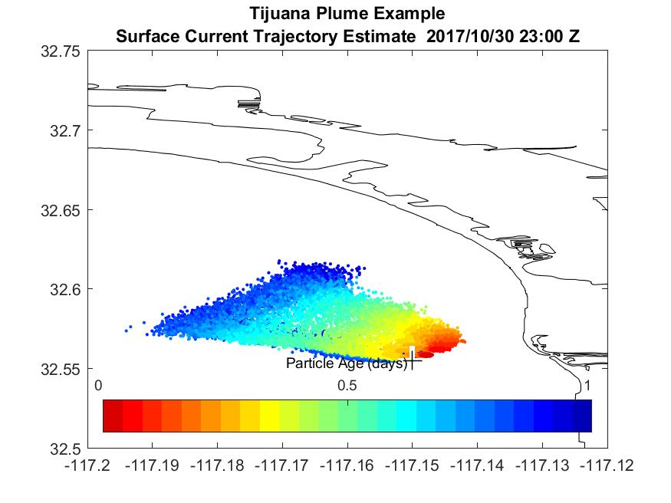
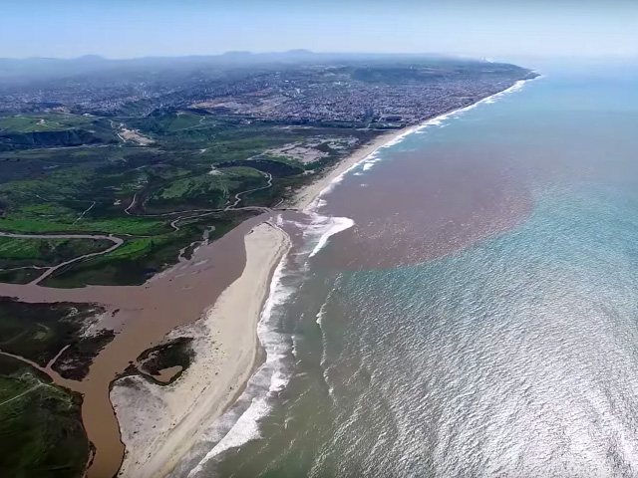
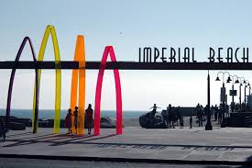
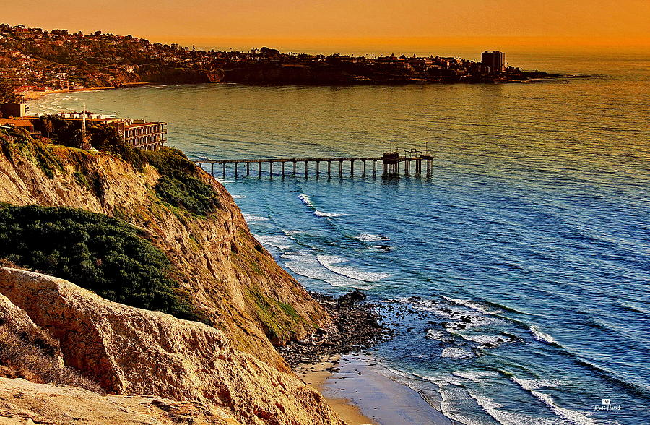
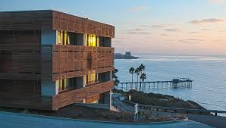
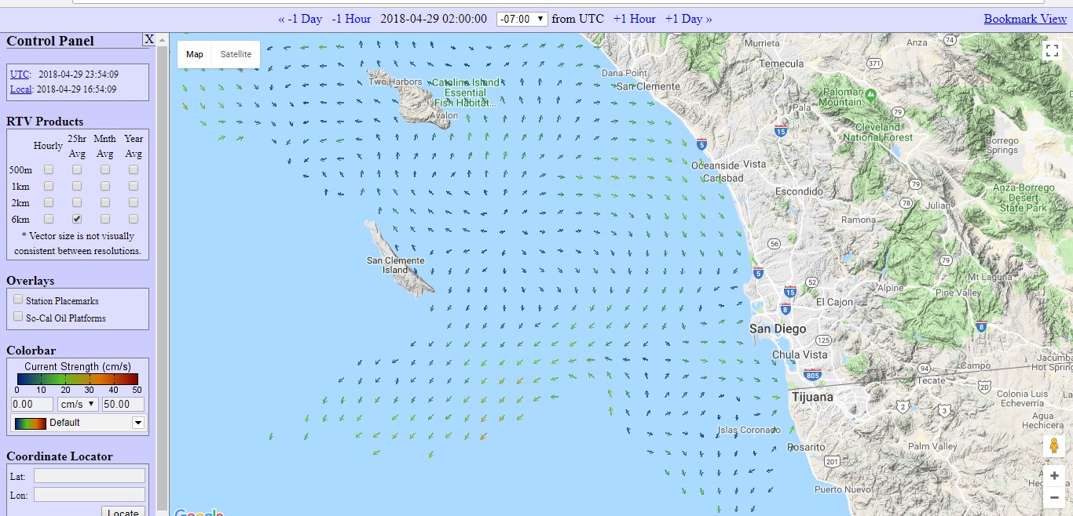
Tracking pollution in the Pacific Ocean Sofia Kwee – Junior, Canyon Crest Academy High School Mentor: Tony de Paolo Coastal Observing Research and Development Center (CORDC)
Santa Ana River Plume
My Project
I wanted to find a way to see the effects of rainwater pollution from the mouths of rivers. I started by looking at the Santa Ana River. Using some of the technology available to the Scripps Institution of Oceanography and with the gracious help of Tony de Paolo, I was able to create a diagram of the predicted direction of the pollution when it entered the water. Because I used a random vector generator, the diagrams are just a prediction based on the known currents plus the random vector. The program Plume Traj adds a very small, random speed and angle to each vector in order to simulate the random movements in the ocean. The simulated plume doubled in size geometrically because the pollution particles were being doubled each time. The initial particles remained stationary and the new particles moved along the current with a little random movement. Anyone can predict the movement of particles in the water by accessing the public site
http://cordc.ucsd.edu/projects/mapping/maps/fullpage.php
This technology is specifically useful in search and rescue. The Coast Guard uses the currents to predict where stranded swimmers might end up. This technology has helped save many people.
Output from the Santa Anna River has the potential to harm many people at neighboring beaches. On a day of heavy rainfall, January 12th, I used CODAR to predict where the pollution could travel on that particular day. The current on January 12th began traveling outward, but then it curved back towards the beach. The current was also traveling slowly northward towards Huntington State Beach. By knowing the direction of the current, the people on Huntington State Beach can be admonished before becoming victims of rainwater pollution.
Tijuana River Plume
Tijuana River
The output from the Tijuana River is a continuous problem for the visitors of Imperial Beach. I chose to calculate the current on November 1st because there was a particularly damaging output that day. The current began traveling northward and west. Then the current began to shift and head east towards the shore. I used the same program in MATLAB as the Santa Ana River, but this time I used it to analyze an issue closer to home. This process is conducted daily to assist the life guards and citizens of Imperial Beach.
“Imperial Beach officials say shoreline hit by Tijuana sewage without warning, residents fall ill”
The San Diego Union Tribune
Doppler Radar
CORDC uses Doppler radar, specifically CODAR (Coastal Ocean Dynamics Applications Radar), to calculate the velocity and direction of the ocean current. This is based off the Doppler effect: a shift in frequency due to a moving object in the radar. The frequency increases when the current is heading towards the radar and decreases when the current is moving away from the radar. The frequency of the reflected signal changes proportionately to the velocity of the current. Currents are measured at a 1km resolution. The transmitted signal is in the HF band (24 MHz). This is a transmitted frequency of 24 million cycles per second. The wavelength is the velocity divided by the frequency. The wavelength of the transmitted electromagnetic wave is 12.5 meters.
HF Radar Website
On November 1st 2017, Imperial Beach was flooded with pollutants from the output of the Tijuana River. This article, published in The San Diego Union Tribune, highlights the frustration of the inflicted people. Many complained about the lack of warning they had before the incident. However, a warning can be given with using the CORDC Doppler radar. By tracking the currents, oceanographers can predict the potential path of the pollutants, and alert the community. This technology will hopefully prevent many illnesses and keep people safe.

